Slide 1
Page replacement algorithm
Page Replacement Algorithm decides which page to remove, also called swap out when a new page needs to be loaded into the main memory.
Page Replacement happens when a requested page is not present in the main memory and the available space is not sufficient for allocation to the requested page.
When the page that was selected for replacement was paged out, and referenced again, it has to read in from disk, and this requires for I/O completion.
This process determines the quality of the page replacement algorithm: the lesser the time waiting for page-ins, the better is the algorithm.

Slide 2
A page replacement algorithm tries to select which pages should be replaced so as to minimize the total number of page misses.
There are many different page replacement algorithms.
These algorithms are evaluated by running them on a particular string of memory reference and computing the number of page faults.
The fewer is the page faults the better is the algorithm for that situation.
If a process requests for page and that page is found in the main memory then it is called page hit , otherwise page miss or page fault .

Slide 3
Why Need Page Replacement Algorithms?
To understand why we need page replacement algorithms, we first need to know about page faults. Let’s see what is a page fault.
Page Fault: A Page Fault occurs when a program running in CPU tries to access a page that is in the address space of that program, but the requested page is currently not loaded into the main physical memory, the RAM of the system.
Since the actual RAM is much less than the virtual memory the page faults occur. So whenever a page fault occurs, the Operating system has to replace an existing page in RAM with the newly requested page. In this scenario, page replacement algorithms help the Operating System in deciding which page to replace. The primary objective of all the page replacement algorithms is to minimize the number of page faults.

Slide 4
Page Replacement Algorithms
First In First Out (FIFO)
FIFO algorithm is the simplest of all the page replacement algorithms.
In this, we maintain a queue of all the pages that are in the memory currently.
The oldest page in the memory is at the front-end of the queue and the most recent page is at the back or rear-end of the queue.
Whenever a page fault occurs, the operating system looks at the front-end of the queue to know the page to be replaced by the newly requested page.
It also adds this newly requested page at the rear-end and removes the oldest page from the front-end of the queue.

Slide 5
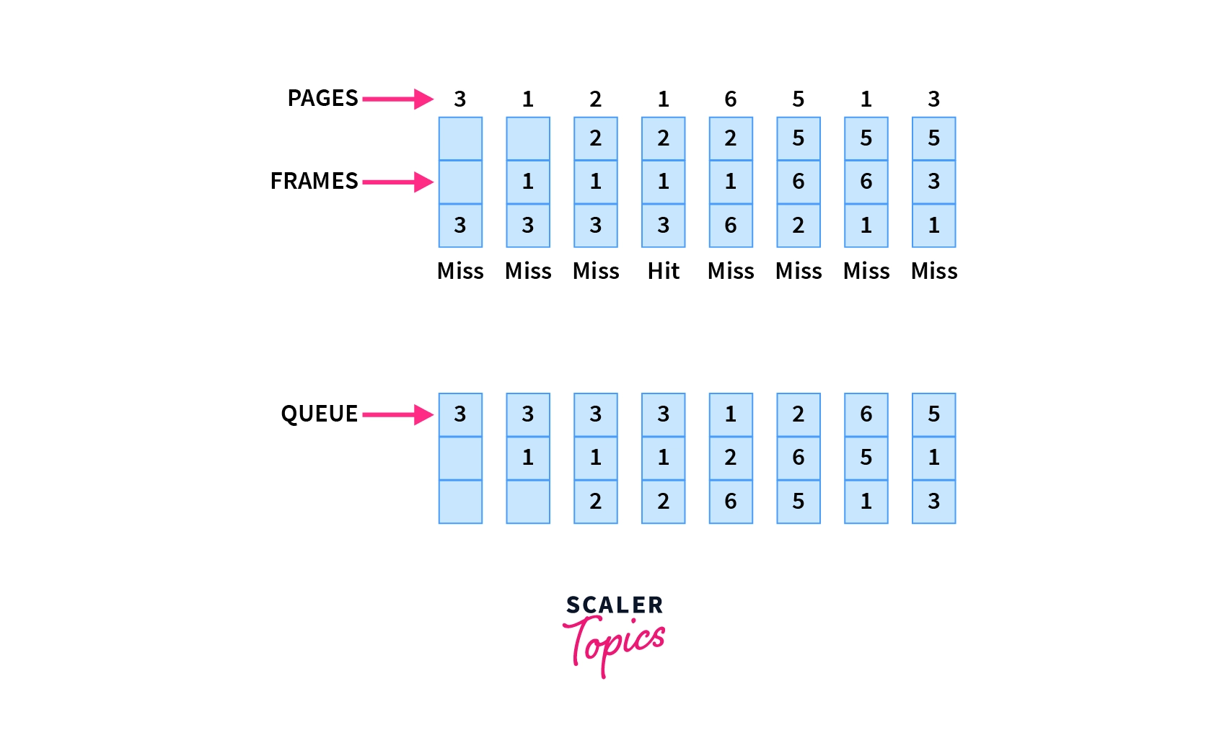

Example: Consider the page reference string as 3, 1, 2, 1, 6, 5, 1, 3 with 3-page frames. Let’s try to find the number of page faults:

Slide 6
Belady's anomaly: Generally if we increase the number of frames in the memory, the number of page faults should decrease due to obvious reasons. Belady’s anomaly refers to the phenomena where increasing the number of frames in memory, increases the page faults as well.
Initially, all of the slots are empty so page faults occur at 3,1,2.
Page faults = 3
When page 1 comes, it is in the memory so no page fault occurs.
Page faults = 3
When page 6 comes, it is not present and a page fault occurs. Since there are no empty slots, we remove the front of the queue, i.e 3.
Page faults = 4

Slide 7
When page 5 comes, it is also not present and hence a page fault occurs. The front of the queue i.e 1 is removed.
Page faults = 5
When page 1 comes, it is not found in memory and again a page fault occurs. The front of the queue i.e 2 is removed.
Page faults = 6
When page 3 comes, it is again not found in memory, a page fault occurs, and page 6 is removed being on top of the queue
Total page faults = 7

Slide 8
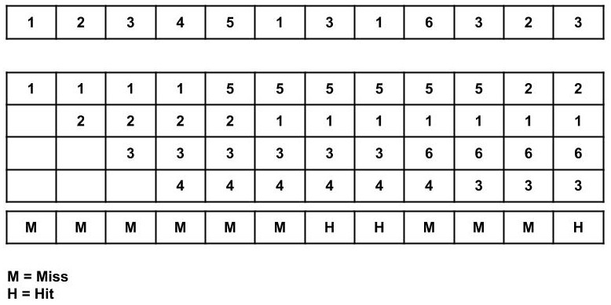
2.Consider the page reference string of size 12: 1, 2, 3, 4, 5, 1, 3, 1, 6, 3, 2, 3 with frame size 4(i.e. maximum 4 pages in a frame).

Slide 9
Total Page Fault = 9
Initially, all 4 slots are empty, so when 1, 2, 3, 4 came they are allocated to the empty slots in order of their arrival. This is page fault as 1, 2, 3, 4 are not available in memory.
When 5 comes, it is not available in memory so page fault occurs and it replaces the oldest page in memory, i.e., 1.
When 1 comes, it is not available in memory so page fault occurs and it replaces the oldest page in memory, i.e., 2.
When 3,1 comes, it is available in the memory, i.e., Page Hit, so no replacement occurs.
When 6 comes, it is not available in memory so page fault occurs and it replaces the oldest page in memory, i.e., 3.

Slide 10
When 3 comes, it is not available in memory so page fault occurs and it replaces the oldest page in memory, i.e., 4.
When 2 comes, it is not available in memory so page fault occurs and it replaces the oldest page in memory, i.e., 5.
When 3 comes, it is available in the memory, i.e., Page Hit, so no replacement occurs.
Page Fault ratio = 9/12 i.e. total miss/total possible cases

Slide 11
Optimal Page Replacement
Optimal page replacement is the best page replacement algorithm as this algorithm results in the least number of page faults.
In this algorithm, the pages are replaced with the ones that will not be used for the longest duration of time in the future.
In simple terms, the pages that will be referred farthest in the future are replaced in this algorithm.

Slide 12
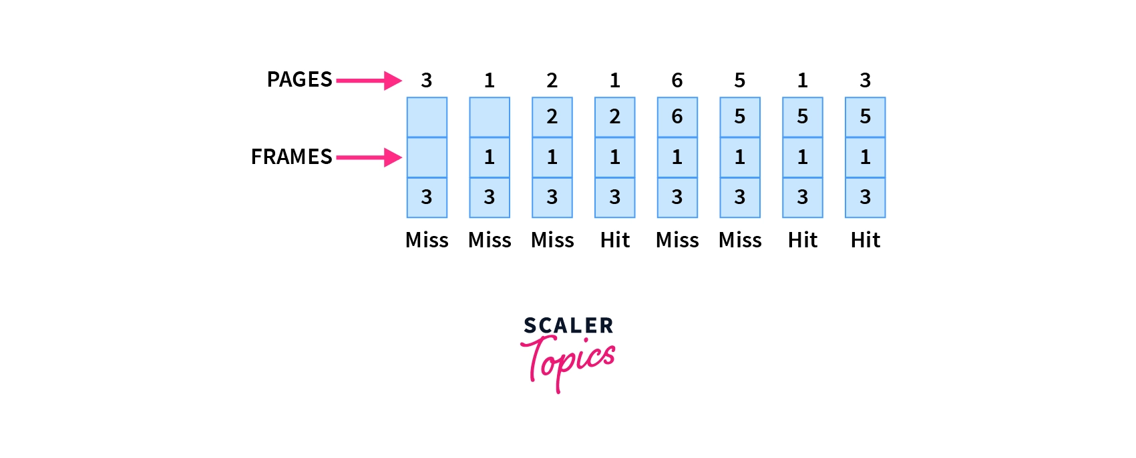

Example: Let6, 5, 1, 3 with 3-page frames as we saw in FIFO. This also helps you understand how Optimal Page replacement works the best.

Slide 13
Initially, since all the slots are empty, pages 3, 1, 2 cause a page fault and take the empty slots.
Page faults = 3
When page 1 comes, it is in the memory and no page fault occurs.
Page faults = 3
When page 6 comes, it is not in the memory, so a page fault occurs and 2 is removed as it is not going to be used again.
Page faults = 4
When page 5 comes, it is also not in the memory and causes a page fault. Similar to above 6 is removed as it is not going to be used again.
page faults = 5
When page 1 and page 3 come, they are in the memory so no page fault occurs.
Total page faults = 5

Slide 14
Advantages
Excellent efficiency
Less complexity
Easy to use and understand
Simple data structures can be used to implement
Used as the benchmark for other algorithms
Disadvantages
More time consuming
Difficult for error handling
Need future awareness of the programs, which is not possible every time

Slide 15
Least Recently Used (LRU) Page Replacement Algorithm
The least recently used page replacement algorithm keeps the track of usage of pages over a period of time.
This algorithm works on the basis of the principle of locality of a reference which states that a program has a tendency to access the same set of memory locations repetitively over a short period of time.
So pages that have been used heavily in the past are most likely to be used heavily in the future also.
In this algorithm, when a page fault occurs, then the page that has not been used for the longest duration of time is replaced by the newly requested page.

Slide 16
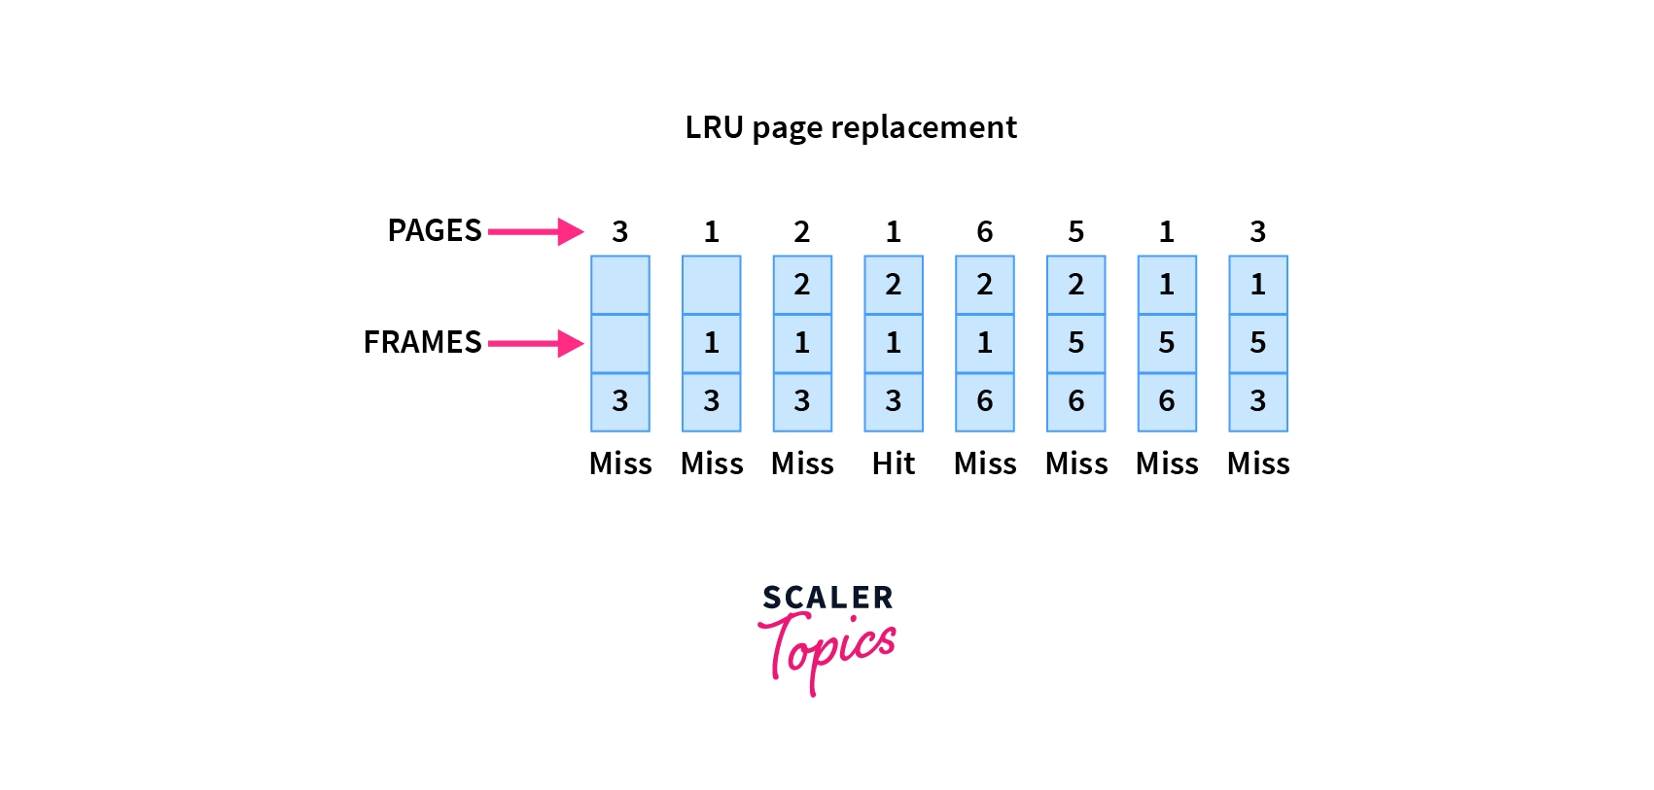

Example: Let’s see the performance of the LRU on the same reference string of 3, 1, 2, 1, 6, 5, 1, 3 with 3-page frames:

Slide 17
Initially, since all the slots are empty, pages 3, 1, 2 cause a page fault and take the empty slots.
Page faults = 3
When page 1 comes, it is in the memory and no page fault occurs.
Page faults = 3
When page 6 comes, it is not in the memory, so a page fault occurs and the least recently used page 3 is removed.
Page faults = 4
When page 5 comes, it again causes a page fault and page 1 is removed as it is now the least recently used page.
Page faults = 5

Slide 18
When page 1 comes again, it is not in the memory and hence page 2 is removed according to the LRU.
Page faults = 6
When page 3 comes, the page fault occurs again and this time page 6 is removed as the least recently used one.
Total page faults = 7
Now in the above example, the LRU causes the same page faults as the FIFO, but this may not always be the case as it will depend upon the series, the number of frames available in memory, etc. In fact, on most occasions, LRU is better than FIFO.

Slide 19
Advantages
It is open for full analysis
Doesn’t suffer from Belady’s anomaly
Often more efficient than other algorithms
Disadvantages
It requires additional data structures to be implemented
More complex
High hardware assistance is required

Slide 20
Last In First Out (LIFO) Page Replacement Algorithm
This is the Last in First Out algorithm and works on LIFO principles.
In this algorithm, the newest page is replaced by the requested page.
Usually, this is done through a stack, where we maintain a stack of pages currently in the memory with the newest page being at the top.
Whenever a page fault occurs, the page at the top of the stack is replaced.

Slide 21
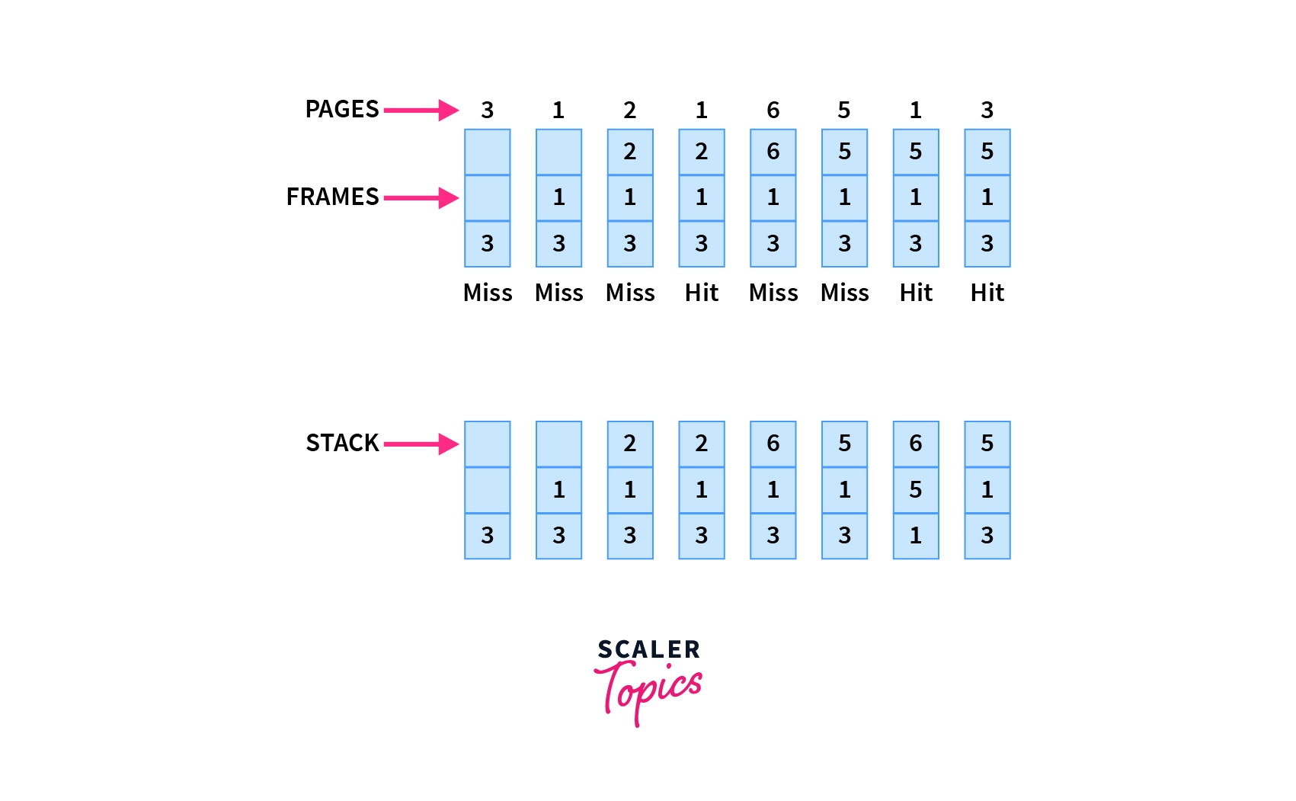

Example: Let’s see how the LIFO performs for our example string of 3, 1, 2, 1, 6, 5, 1, 3 with 3-page frames:

Slide 22
Initially, since all the slots are empty, page 3,1,2 causes a page fault and takes the empty slots.
Page faults = 3
When page 1 comes, it is in the memory and no page fault occurs.
Page faults = 3
When page 6 comes, the page fault occurs and page 2 is removed as it is on the top of the stack and is the newest page.
Page faults = 4
When page 5 comes, it is not in the memory, which causes a page fault, and hence page 6 is removed being on top of the stack.
Page faults = 5
When page 1 and page 3 come, they are in memory already, hence no page fault occurs.
Total page faults = 5
As you may notice, this is the same number of page faults as of the Optimal page replacement algorithm. So we can say that for this series of pages, this is the best algorithm that can be implemented without the prior knowledge of future references.

Slide 23
Advantages
Simple to understand
Easy to implement
No overhead
Disadvantages
Does not consider Locality principle, hence may produce worst performance
The old pages may reside in memory forever even if they are not used

Slide 24
Random Page Replacement
This algorithm, as the name suggests, chooses any random page in the memory to be replaced by the requested page.
This algorithm can behave like any of the algorithms based on the random page chosen to be replaced.
Example: Suppose we choose to replace the middle frame every time a page fault occurs. Let’s see how our series of 3, 1, 2, 1, 6, 5, 1, 3 with 3-page frames perform with this algorithm:

Slide 25
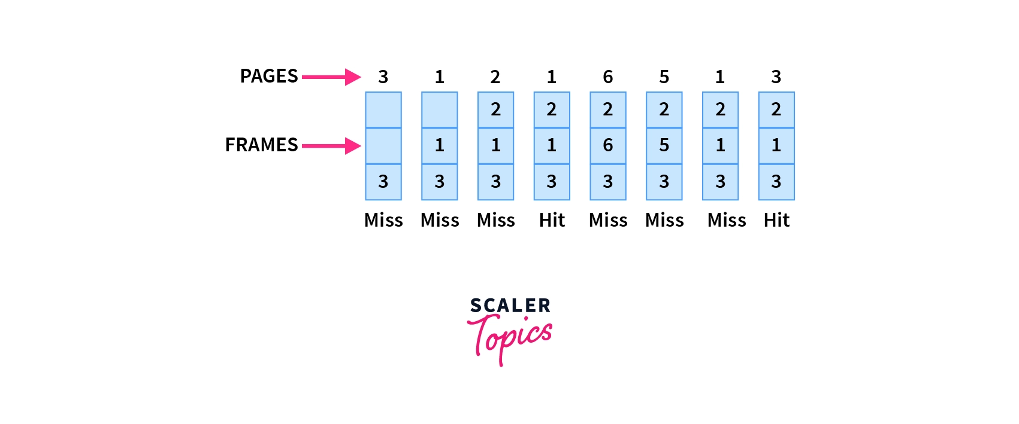


Slide 26
Initially, since all the slots are empty, page 3,1,2 causes a page fault and takes the empty slots
Page faults = 3
When page 1 comes, it is in the memory and no page fault occurs.
Page faults = 3
When page 6 comes, the page fault occurs, we replace the middle element i.e 1 is removed.
Page faults = 4
When page 5 comes, the page fault occurs again and middle element 6 is removed
Page faults = 5

Slide 27
When page 1 comes, there is again a page fault and again the middle element 5 is removed
Page faults = 6
When page 3 comes, it is in memory, hence no page fault occurs.
Total page faults = 6
As we can see, the performance is not the best, but it's also not the worst. The performance in the random replacement algorithm depends on the choice of the page chosen at random.

Slide 28
Advantages
Easy to understand and implement
No extra data structure needed to implement
No overhead
Disadvantages
Can not be analyzed, may produce different performances for the same series
Can suffer from Belady’s anomaly

Slide 29
Q1.
Consider the following page reference string:
1, 2, 3, 4, 2, 1, 5, 6, 2, 1, 2, 3, 7, 6, 3, 2, 1, 2, 3, 6.
How many page faults would occur for the following replacement algorithms, assuming one, two, three, four, five, six, and seven frames? Remember that all frames are initially empty, so your first unique pages will cost one fault each.
• LRU replacement
• FIFO replacement
• Optimal replacement

Slide 30
Q2.
Consider the following page reference string:
7, 2, 3, 1, 2, 5, 3, 4, 6, 7, 7, 1, 0, 5, 4, 6, 2, 3, 0 , 1.
Assuming demand paging with three frames, how many page faults would occur for the following replacement algorithms?
• LRU replacement
• FIFO replacement
• Optimal replacement

Slide 31
THANK YOU..!!!!

